Slide 1


Anatomy of Epithelial Tissues
Dr. Mahdi H. Hammadi
PhD Sc. Clinical Physiology

Slide 2
Epithelial tissue : type of tissue that lines the surfaces and cavities of your body's organs
Epithelium has two names. The first name indicates the number of cell layers, the second describes the shape of its cell. Based on the number of cell layers, epithelia can either be simple or stratified.
Simple epithelia– consist of a single cell layer (
Stratified epithelia– are composed of two or more cell layers

Slide 3
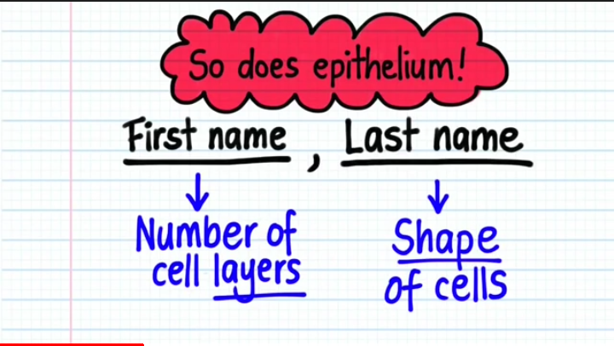

Slide 4
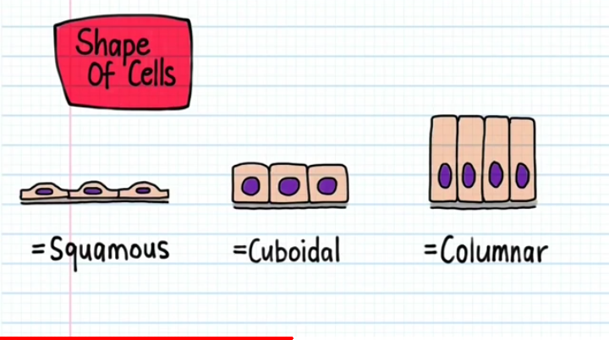

Slide 5
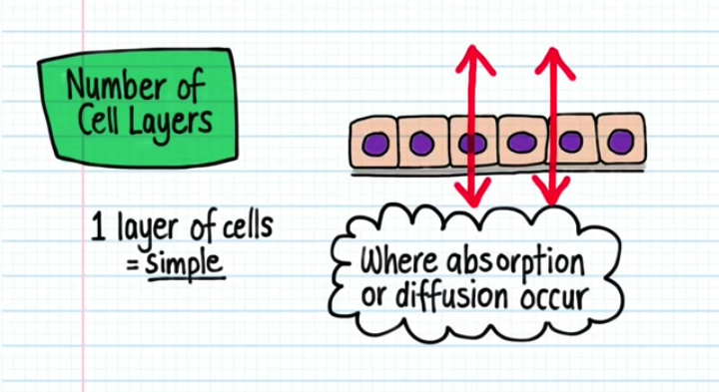

Slide 6
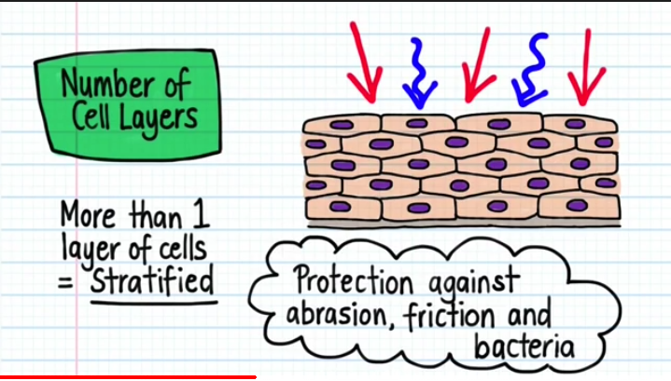

Slide 7
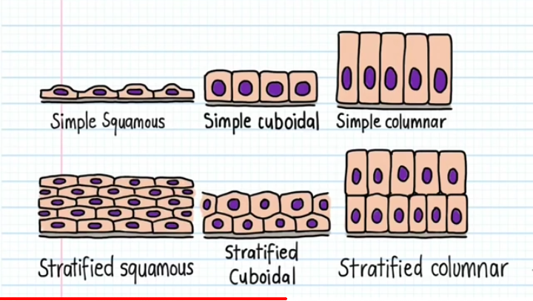

Slide 8
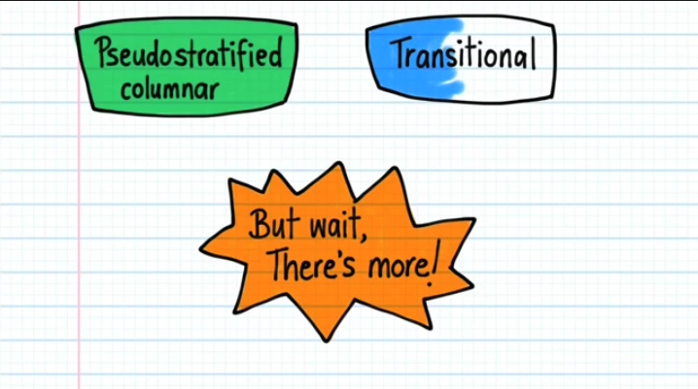

Slide 9
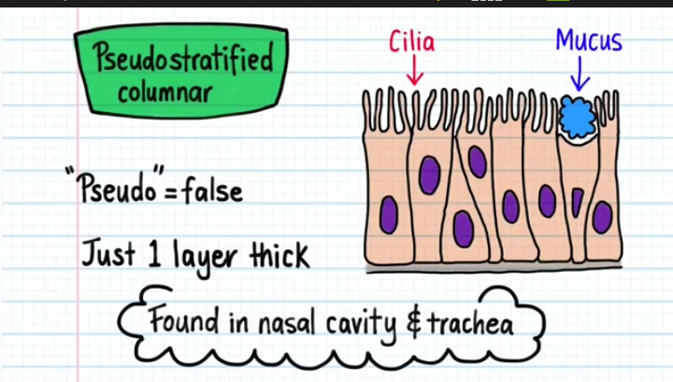

Slide 10
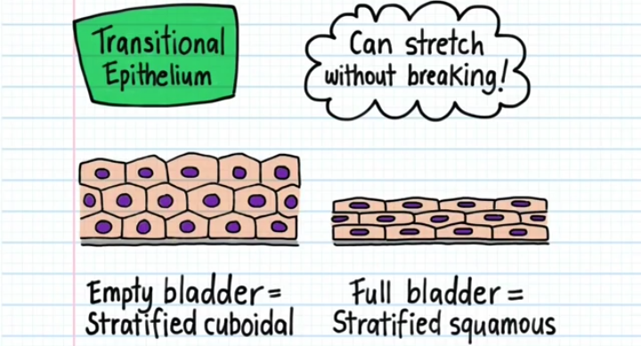

Slide 11
